Slide 1
Work, Power & Energy
Another Perspective on Motion

Slide 2
Energy
The measure of a system’s capacity
to do _____________
Two types of _____________________ energy
  Kinetic Energy
    Energy of ___________
    KE =
  Gravitational Potential Energy
    Energy due to an object’s ___________________
    PE =
    Units of energy are N.m = Joules (J)
Note the effect of velocity

Slide 3
A few notes about gravitational PE
PE is always defined __________________________which must be defined in each problem
It is possible for PE to be__________ or ________ depending on whether the object is above or below the defined zero point.
Does the student sitting in the desk have PE?
It depends…
Relative to the ground…yes
Relative to the chair…no

Slide 4
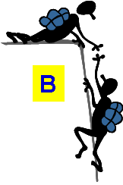

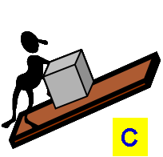

In which situation does the object gain more gravitational potential energy (relative to the ground)?
t = 8 s
Fg = 600 N
2.
t = 4
Fg = 700 N
h = 5 m
3.
t = 5 s
Fg = 400 N
h = 5 m
h = 5 m
4.
d = 4 m
d = 6 m

Slide 5
Which two objects have the same KE? (within proper sig. figs.)
A
B
C
D
A)
C)
m = 9100 kg
v = 4.5 m/s
m = 1100 kg
v = 16.1 m/s
D)
B)
m = 730 kg
v = 15.9 m/s
m = 36,400 kg
v = 15.0 m/s

Slide 6
Which two objects have the same KE? (within proper sig. figs.)
KE = 92,000 J
A
B
C
D
KE = 140,000 J
A)
C)
m = 9100 kg
v = 4.5 m/s
m = 1100 kg
v = 16.1 m/s
KE = 4100000 J
KE 92,000 J
D)
B)
m = 730 kg
v = 15.9 m/s
m = 36,400 kg
v = 15.0 m/s

Slide 7
How to solve conservation of energy problems…
Draw of picture of the situation
Label what you know in the picture
You will always be comparing two different points to each other
  Many time these points are where the KE or PE is maximum
  Set the KE + PE at point 1 equal to the
  KE + PE at point 2
Solve for the unknown quantity

Slide 8
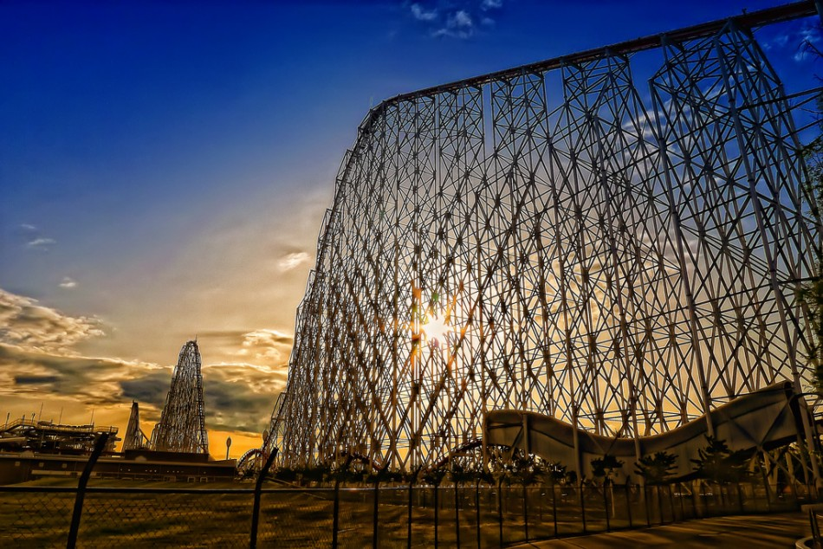
Work done by motor to raise you up the lift hill. Provides all the energy at the top of the hill.
Point 1= highest point
E_{top}= PE_{top} + KE_{top}
Steel Dragon 2000 in Mie, Japan
306 ft drop (convert to meters)
Calculate speed at bottom of drop
  Total Energy at Top = Total Energy at Bottom
  PE_{top} + KE_{top} = PE_{bottom} + KE_{bottom}
  PE_{top} = KE_{bottom}
  mgh = 1/2 mv²
  v = 42.6 m/s = 95.4 mph!!!!!
Point 2= bottom of hill
E_{bottom} = PE_{bottom} + KE_{bottom}
Why doesn’t mass matter?
Notes:
Steel Dragon does achieve 95 mph. Top Thrill Dragster at CedarPoint under construction will have 400 foot drop and achieve 120 mph.
Photo http://www.geocities.com/coaster_feature1/sd2000.html

Slide 9
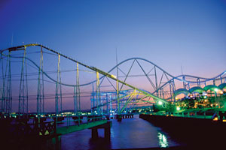
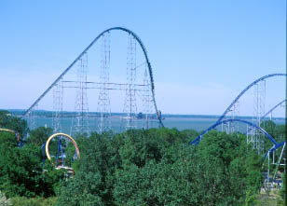
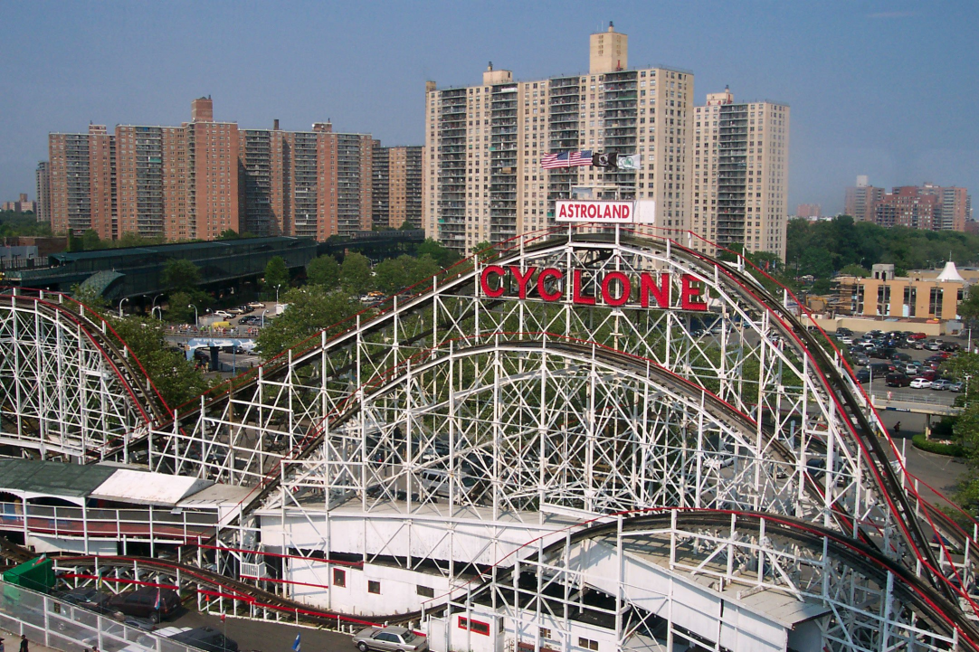
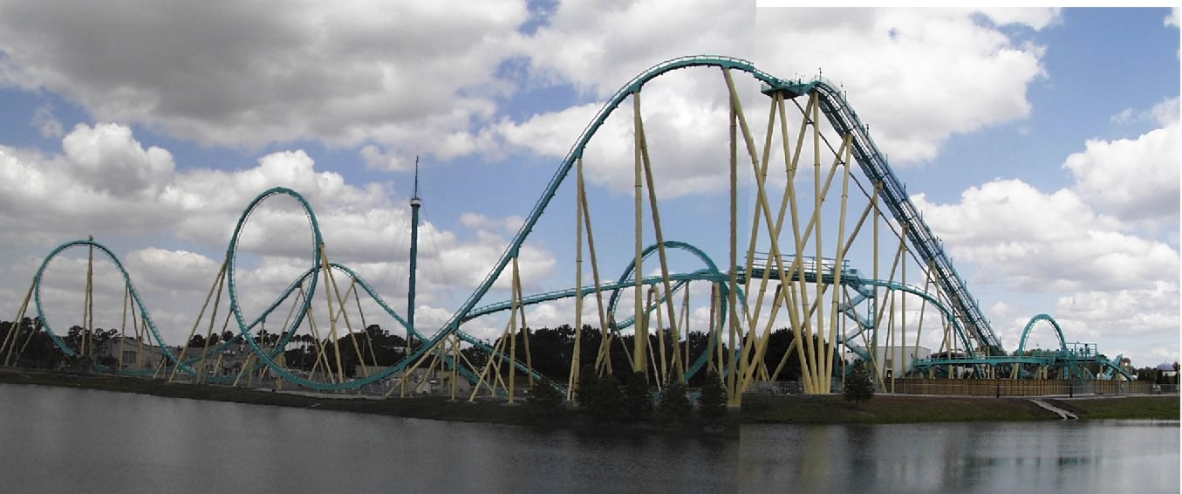
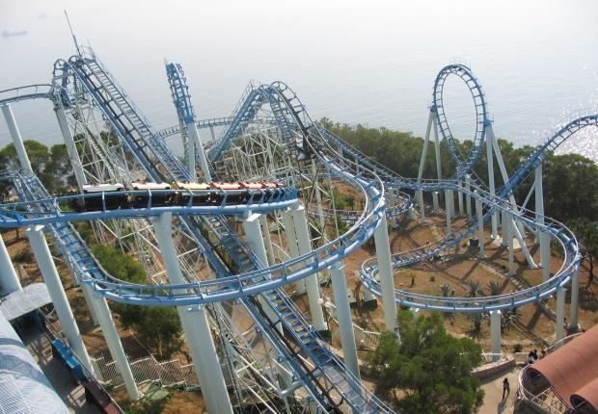
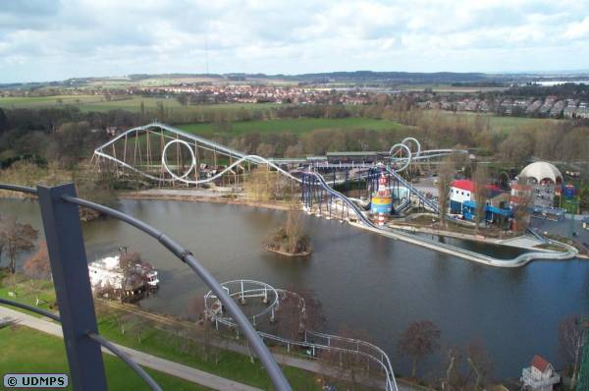
Coaster Design – What’s similar?

Slide 10
Coaster Characteristics
Highest point is ______________ hill
Loops near the ______________ of the ride, unless small
Sharper turns near ____________ of ride
______________ only used to get riders to top of first hill

Slide 11
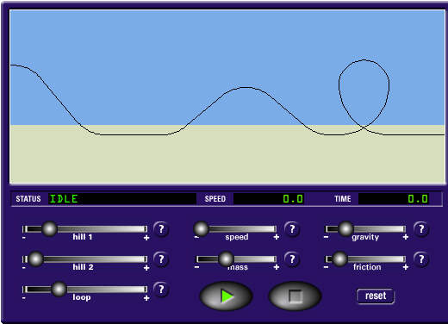
Looped Rollercoasters
http://www.funderstanding.com/k12/coaster/

Slide 12
Work
Work transfers ____________ from one form to another
Three criteria for work to be done in a physics sense:
  _____________ must be applied,
  Object must _____________
  Object’s movement, or some part of it, must be in the ________________ of the force.

Slide 13
In which situation is more work done against gravity?
t = 8 s
Fg = 600 N
Climbing stairs
Climbing rope
Pushing box up incline
All are the same
B.
A.
t = 4
Fg = 700 N
h = 5 m
C.
t = 5 s
Fg = 400 N
h = 5 m
h = 5 m
D.
d = 4 m
d = 6 m

Slide 14
In which situation is more power generated?
t = 8 s
Fg = 600 N
Climbing stairs
Climbing rope
Pushing box up incline
All are the same
B.
A.
t = 4
Fg = 700 N
h = 5 m
C.
t = 2 s
Fg = 400 N
h = 5 m
h = 5 m
D.
d = 4 m
d = 6 m

