Slide 1
Law of Reflection = angle of ____________ is equal to the angle of _______________
Θ_{i} = Θ_{r}

Slide 2
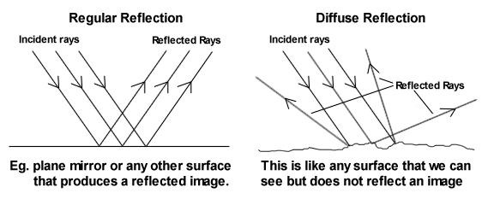
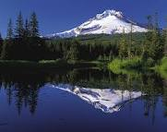
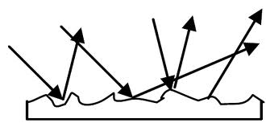
Diffuse vs Regular Reflections

Slide 3
Image Characteristics
L
O
S
T

Slide 4
Location
Relative location of an image:
For a _____ (flat) mirror:
The image is always the ______ distance from the mirror as the object.
For a __________ mirror:
The mirror equation is used because the image location depends on the curvature of the mirror.
‘f’ =
‘d_{o}’ =
‘d_{i}’ =

Slide 5
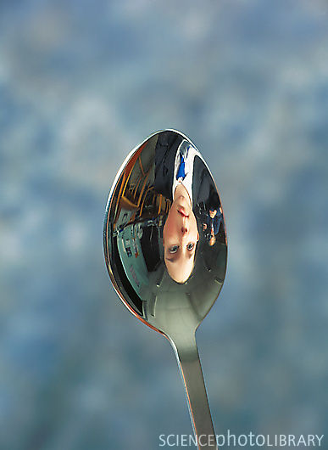
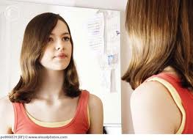
Orientation

Slide 6
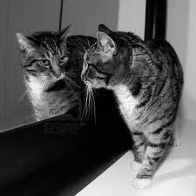
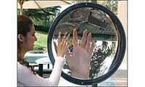
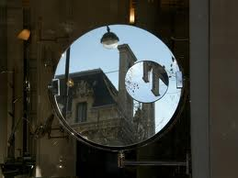
Size
Reduced

Slide 7
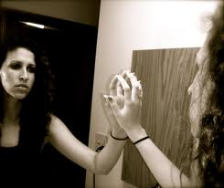
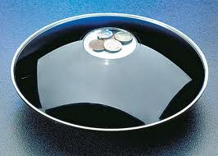
Type
_____ – formed in a place where light can reach
________ – formed where light CANNOT reach

