Slide 1
to Physics
“You cannot discover new oceans unless you are willing to lose sight of the shore.”
Notes:
Welcome gif: http://www.fg-a.com/welcome.htm

Slide 2
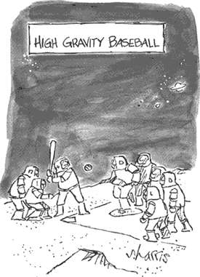
How do you know if something is in motion?
Notes:
http://www.sciencecartoonsplus.com/galphys2b.htm#
Go to weebly page and do the ‘frame of reference’ activity

Slide 3
Develop categories for the following types of motion:
Rock dropped into pond
Driving down I-90 to Sioux Falls
Space shuttle being launched
Riding a Ferris wheel
Driving in the Daytona-500
Downhill skiing
A spinning top
A leaf falling from a tree
Drag racing
Waterfall
Moon orbiting the Earth
Bullet fired from a gun

Slide 4
Possible Categories
Constant speed
Falling leaf
Driving to Sioux Falls
Affected by gravity
Shuttle launch
Downhill skiing
Waterfall
Bullet from gun
Rock dropped in pond
Circular/Rotational motion
Ferris wheel
Spinning top
Daytona 500
Moon’s orbit
Changing speed
Drag racing
(all from gravity category)

Slide 5
Motion
None
Uniform
Accelerated
Changing
speed and/or
direction
Constant
speed and
direction
v = Δd/Δt
a = Δv/Δt

Slide 6
Significant Figures AKA Determine the ‘weakest link’
Non-zeroes are always significant
Zeroes are sometimes significant
Ex. 8200? How many are significant?
Ex. 8.200 x 10³ How many are significant?
Multiplying & Dividing –
The answer should equal the least # of sig figs in any of the numbers used. Ex. 1.1 x 2 x 2.55 = ?
Adding & Subtracting –
The answer should be the same as the least # of decimal places in the numbers used. Ex. 10.8
- 4.35 = ?

Slide 7
Try these examples:
(A x B)/C = ? Where A= 483J, B=73.67J and C = 15.67
a. 2270.7 J²
b. 2270 J²
c. 2.27 x 10³ J²
d. 2271 J²
X + Y + Z = ? Where X = 48.1, Y = 77, and Z = 65.789
a. 191
b. 190.889
c. 190.8
d. 190.9

