Slide 1
Homework Quiz #1
Projectile Motion

Slide 2
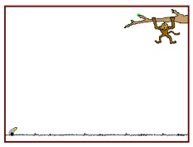
A zookeeper devises a rubber-band gun to shoot food to a monkey who is too shy to come down from the trees.
If the monkey does not move, where should the keeper aim?
Above the monkey
At the monkey
Below the monkey

Slide 3
A zookeeper devises a rubber-band gun to shoot food to a monkey who is too shy to come down from the trees.
If the monkey lets go of the branch at the instant the keeper shoots the food, where should he aim?
Above the monkey
At the monkey
Below the monkey

Slide 4
The monkey problem only works if…
He shoots the gun so that the banana travels very fast.
He shoots the gun so that the banana travels slowly.
He shoots the gun so that the banana travels at a medium speed.
It doesn’t matter how fast the gun shoots the banana.

Slide 5
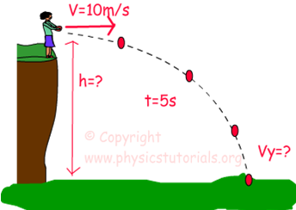
What is the height of the cliff?
2 meters
15 meters
50 meters
125 meters

Slide 6
How far did the ball go? (what is the range of the ball?)
2 meters
15 meters
50 meters
125 meters

Slide 7
What is the vertical speed (Vy) of the ball just before it hits the ground?
4 m/s
10 m/s
25 m/s
50 m/s

