Slide 1
Electrostatics
INDUCTION

Slide 2
Charging by Induction
Charging an object __________ actually touching it to another charged object.
Subject always becomes _____________ charged to the charged object brought near.

Slide 3
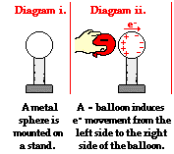
Charging a Single Object
Step 1:
(this is called
the ___________
step)

Slide 4
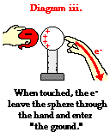
Charging a Single Object
Step 2
(this is the
___________
step)

Slide 5
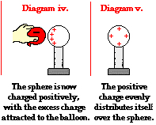
Charging a Single Object
Step 3
(Charge
____________)
What is wrong
with this
diagram?

Slide 6
Negatively Charging a Single Object

Slide 7
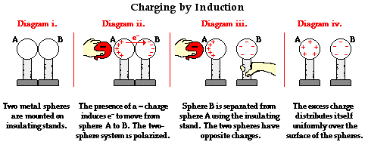
Charging a two-sphere object

Slide 8
A positively charged balloon is brought near a neutral conducting sphere as shown below. While the balloon is near, the sphere is touched (grounded).
At this point, there is a movement of electrons. Electrons move ____ .
a. into the sphere from the ground (hand)
b. out of the sphere into the ground (hand)
c. into the sphere from the balloon
d. out of the sphere into the balloon
e. from the ground through the sphere to the balloon
f. from the balloon through the sphere to the ground
g. .... nonsense! Electrons do not move at all.

