Slide 1
True or False?
1. When a battery no longer works, it is out of charge and must be re-charged before it can be used again.
2. A battery can be a source of charge in a circuit. The charge which flows through the circuit originates in the battery.
3. Charge becomes used up as it flows through a circuit. The amount of charge which exits a light bulb is less than the amount which enters the light bulb.

Slide 2
True or False?
4. Charge flows through circuits at very high speeds. This explains why the light bulb turns on immediately after the wall switch is flipped.
5. Northwestern Power supplies millions and millions of electrons to our homes everyday.

Slide 3
Electricity
…when charge is no longer static….

Slide 4
Two Requirements to maintain charge flow in an electrical circuit:
An external energy supply to establish a potential difference across the circuit.
A closed conducting loop between the + and – terminals.
Once these conditions are met an electric current or flow of charge will occur.

Slide 5
Voltage in DC Circuits
Supplied by battery or type of power supply
Provides the “________” of charge through the circuit
Potential energy __________ at one end than other
Circuit symbol:

Slide 6
Resistance
Results from electrons ___________ with atoms in a given material
Results in ___________
Measure of opposition to _______________
Measured in ohms, Ω
Components provide resistance
Symbol in a circuit:

Slide 7
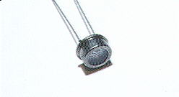
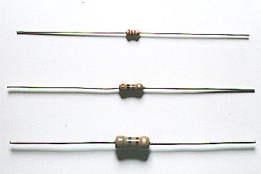
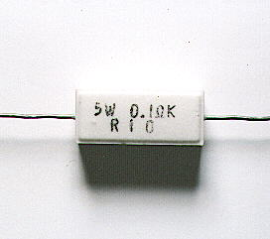
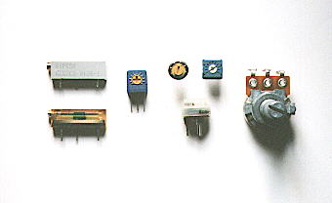
Examples of Resistors
Fixed
CDS Photocell
Ceramic
Variable

Slide 8
Resistance
Depends on
_____________________ of material
Length
Longer wire = ________ resistance
Diameter
___________ wire = higher resistance
Temperature
Higher temperature = _____________ resistance

Slide 9
Electric potential (V) difference between the two terminals ________________the movement of charge, it is resistance (Ω) that ______________________ it.
The rate at which charge flows from terminal to terminal is the result of the combined affect of these two quantities.

Slide 10
What are the two ways we can alter the amount of current?

Slide 11
Electric Current
A flow of charged particles
By convention, positive charge flows (though really negative)
Current = charge/time
I = current (amperes or amps)
q = charge (coulombs) t = time (seconds)

Slide 12
Current vs. drift speed
Current is the rate at which charges pass a certain point – based on # of charges NOT speed.
Notes:
In 1/10 of a mm of copper wire there are 3.51 x 10(20) atoms – that’s a lot of free electrons!

Slide 13
Ohm’s Law
ΔV = I x R
Relationships…When one variable is kept constant then…
V & I – _____________
V & R – _____________
I & R - _____________

Slide 14
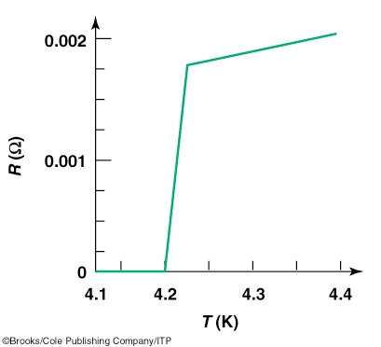
Superconductor
Material with no resistance
Newer superconductors have zero resistance around 140 K
Advantage: cheaper liquid nitrogen can be used instead of liquid helium
Disadvantage: more difficult to use because brittle

Slide 15
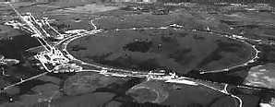
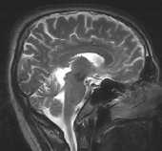
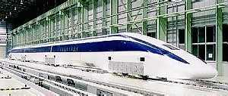
Applications of Superconductivity
Notes:
source: http://superconductors.org/Uses.htm

Slide 16
Electrocution
Human body is mostly water and ions so can be a good conductor
Resistance depends on if body wet or dry and distance between parts in the circuit
Resistance varies from 100 Ω - 500,00 Ω
Sensitivity to current
0.001 amps can be felt
0.005 amps is painful
0.010 amps can cause muscle spasms
0.015 amps causes loss of muscle control
0.070 amps, if through heart, likely fatal

