Slide 1
Electrical Charge
Atoms composed of charges but overall are neutral
protons(+), electrons(-), and neutrons
Basic unit of charge,
Electron q = _______________
Proton q = _______________
When objects become “charged” only the electrons have been affected
proton bound in the nucleus of an atom

Slide 2
Electric Forces
Attracting and repelling behavior is called “_________”
Like charges repel
Unlike charges attract
Objects charged by
_____________ = rubbing
______________ = touching
______________ = indirect means
positive charge = fewer electrons than protons
negative charge = more electrons than protons

Slide 3
Electric Force
Coulomb’s Law
The ____________ acting on each of two charged objects is ___________ proportional to the __________ of the distance between them.
4 F
F
+q
-q
-q
+q
½ d
d

Slide 4
Electric Force
Coulomb’s Law (equation form)
F = force (Newtons, N)
q = charge (Coulombs, C)
k = constant = 9.0 x 10⁹ N.m²/C² d = distance (m)

Slide 5
If two charges of 2.0 x 10⁻⁵ C are separated by 45 cm, how much electrostatic force is acting on each?
180 N
1.8 x 10⁻⁹ N
1.8 x 10⁻³ N
18 N
None of the above
Did not finish the problem
10
0
of
66
Notes:
D

Slide 6
If a force of 2.5 N is acting between two charges of 6.8 x 10⁻⁶ C, what is the distance between the charges?
6.5 cm
28 cm
9.4 cm
41 cm
None of the above
Notes:
D

Slide 7
Two equal charges are separated by 6 cm. The attractive force between them is 20 N. What is the magnitude of each charge?
6.4 x 10⁻²³ C
4.1 x 10⁻⁴⁵ C
2.8 x 10⁻⁶ C
3.7 x 10⁻⁹ C
None of the above
Notes:
C

Slide 8
Charging video
Link: http://www.youtube.com/watch?v=o0hXYfvnND0

Slide 9
Charging by Induction
Charging an object without actually touching it to another charged object.
Subject always becomes oppositely charged to the charged object brought near.

Slide 10
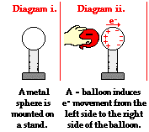
Charging a Single Object
Step 1:
(this is called
the polarizing
step)

Slide 11
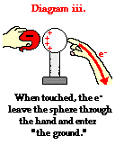
Charging a Single Object
Step 2
(this is the
grounding
step)

Slide 12
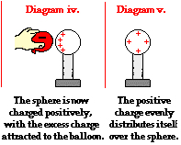
Charging a Single Object
Step 3
(Charge
redistribution)
What is wrong
with this
diagram?

Slide 13
Negatively Charging a Single Object

Slide 14
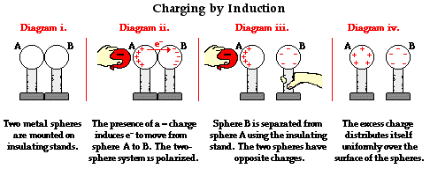
Charging a two-sphere object

