Slide 1
Rotating objects tend to keep rotating while non-rotating objects tend to remain non-rotating.

Slide 2
12.1 Rotational Inertia
The _______________ the rotational inertia, the more ______________ it is to change the rotational speed of an object.
Think of it as rotational _________________.
Just as it takes a force to change the linear state of motion of an object, a __________ is required to _______________ the rotational state of motion of an object.

Slide 3
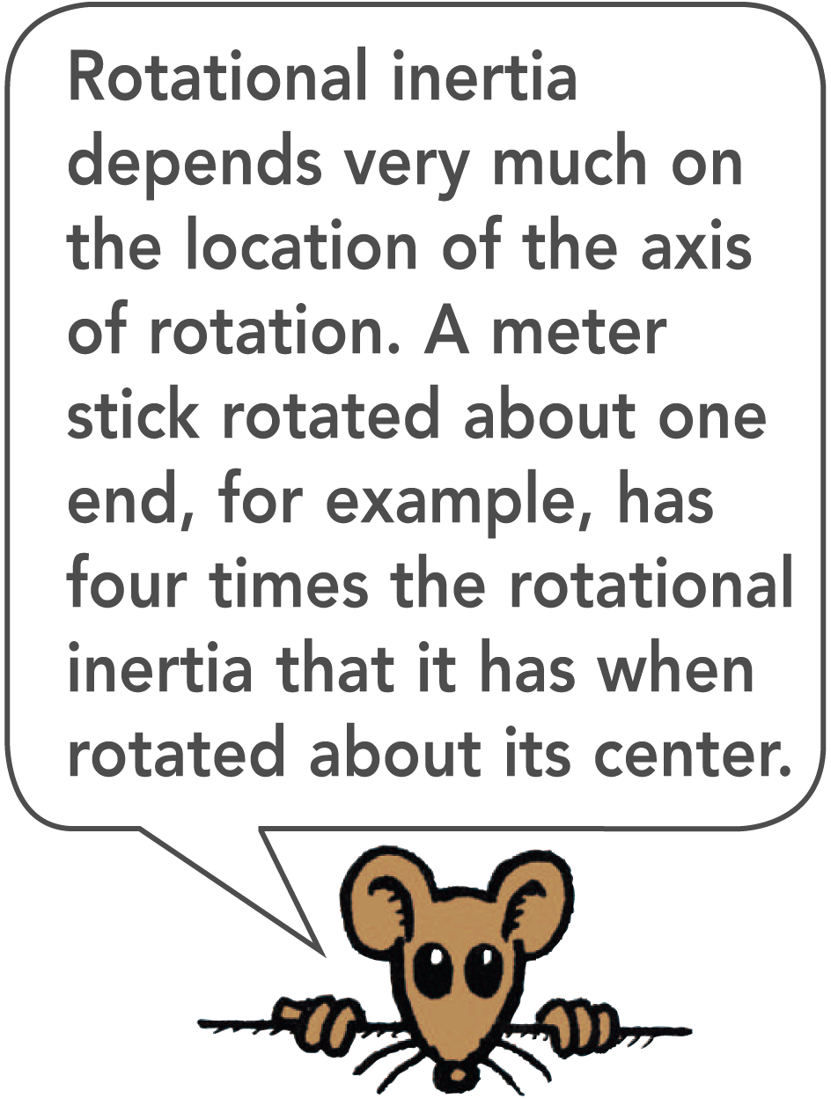
12.1 Rotational Inertia
Rotational Inertia and Mass
Like inertia in the linear sense, rotational inertia depends on mass, but unlike inertia, rotational inertia depends on the ________________ of the mass.
The greater the ________________ between an object’s mass concentration and the axis of rotation, the greater the rotational inertia (laziness).

Slide 4
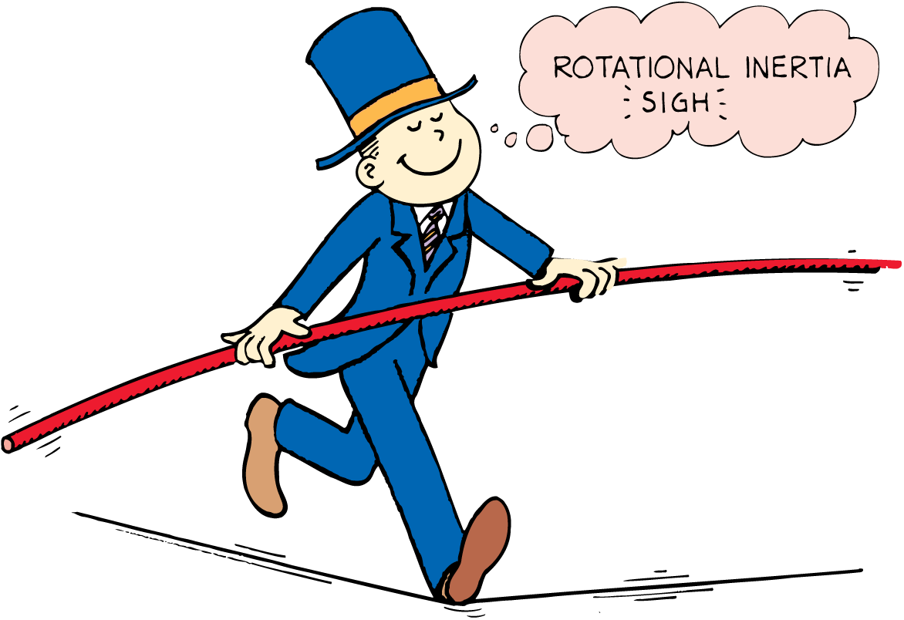
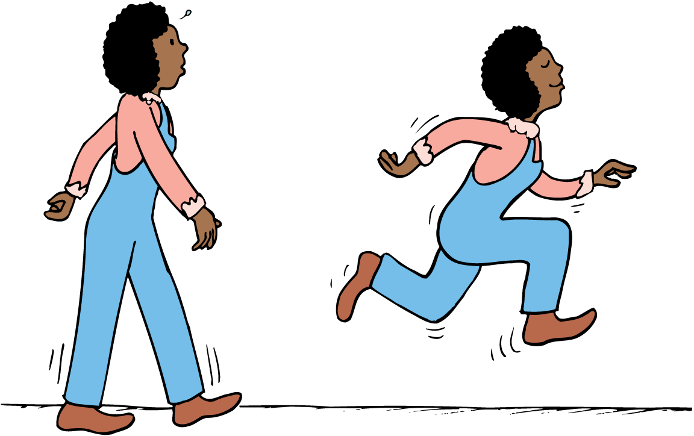

Slide 5
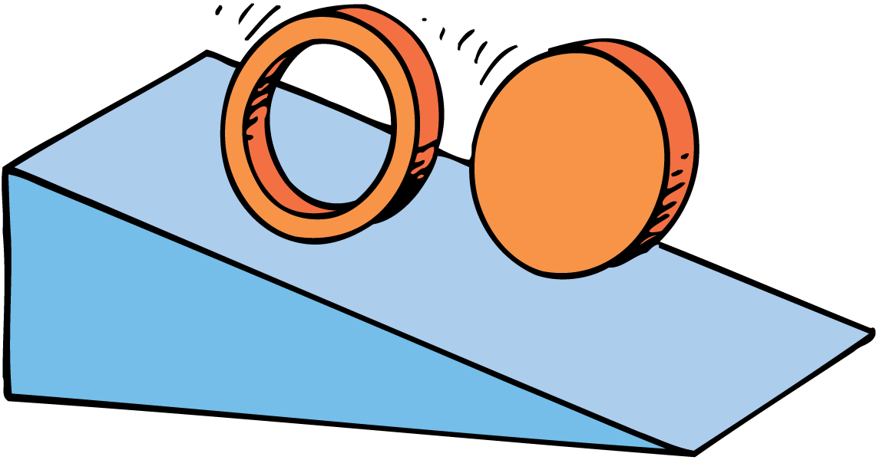
12.3 Rotational Inertia and Rolling
A ____________ cylinder always rolls down an incline __________ than a hollow one, whether or not they have the same mass or diameter.
LAZY

Slide 6
12.3 Rotational Inertia and Rolling
think!
A heavy iron cylinder and a light wooden cylinder, similar in shape, roll down an incline. Which will have more acceleration?
The cylinders have different masses, but the same rotational inertia per mass, so both will accelerate equally down the incline. Their different masses make no difference, just as the acceleration of free fall is not affected by different masses. All objects of the same shape have the same “laziness per mass” ratio.

Slide 7
12.3 Rotational Inertia and Rolling
think!
Would you expect the rotational inertia of a hollow sphere about its center to be greater or less than the rotational inertia of a solid sphere? Defend your answer.

Slide 8
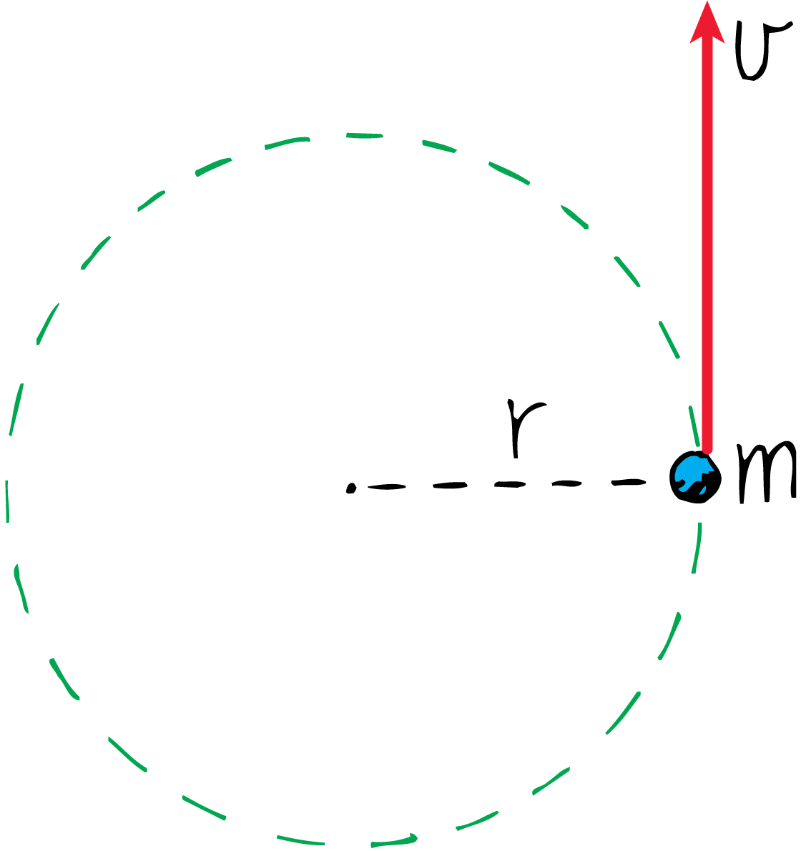
12.4 Angular Momentum
An object of concentrated mass m whirling in a circular path of radius r with a speed v has angular momentum __________.

Slide 9
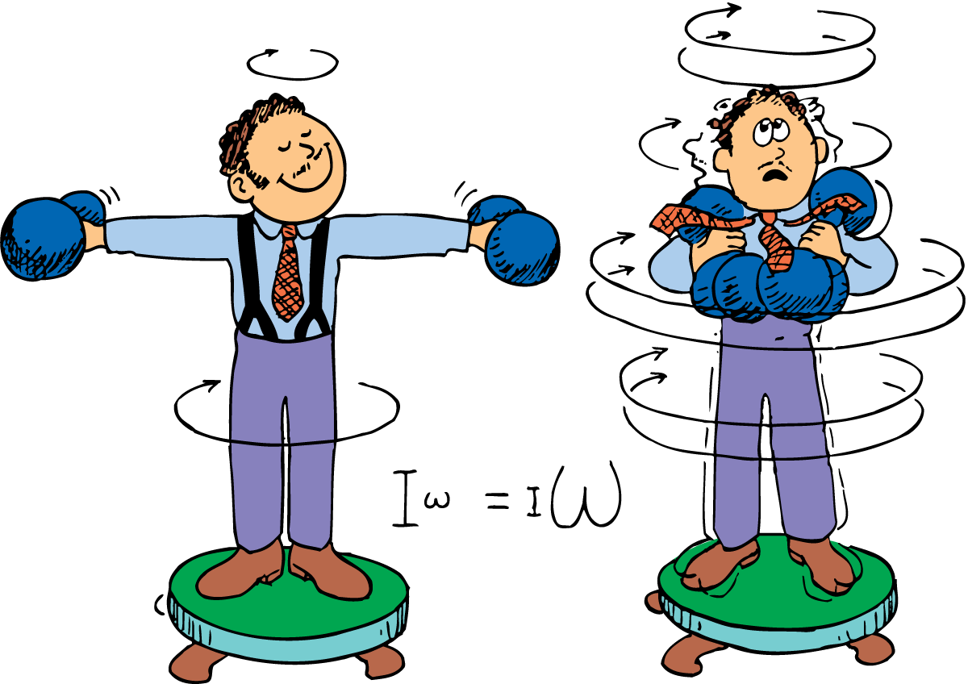
12.5 Conservation of Angular Momentum
The law of conservation of angular momentum states that if no _____________________________acts on a rotating system, the angular momentum of that system is ___________.
With no external torque, the ___________ of rotational inertia and rotational velocity at one time will be the ___________ as at any other time.

Slide 10
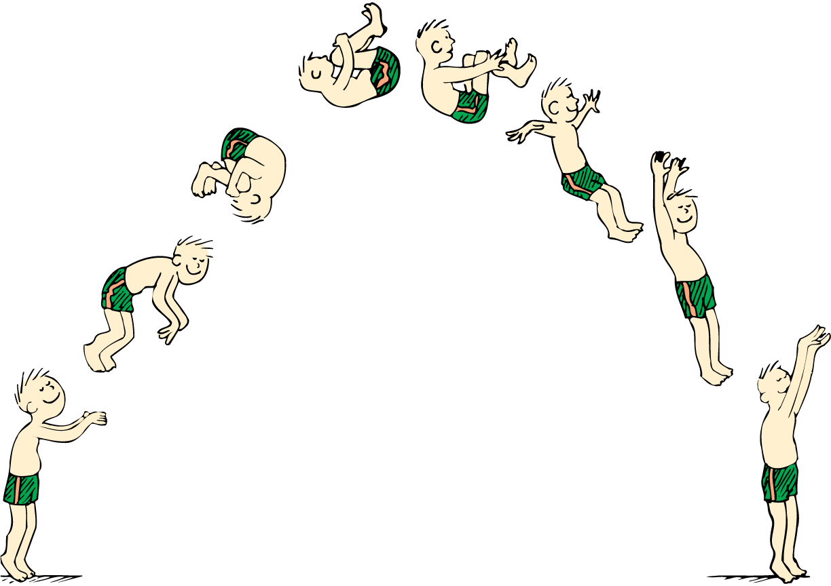

Slide 11
Assessment Questions
The rotational inertia of an object is greater when most of the mass is located
near the center.
off center.
on the rotational axis.
away from the rotational axis.

Slide 12
Assessment Questions
For round objects rolling on an incline, the faster objects are generally those with the
greatest rotational inertia compared with mass.
lowest rotational inertia compared with mass.
most streamlining.
highest center of gravity.

Slide 13
Assessment Questions
For an object traveling in a circular path, its angular momentum doubles when its linear speed
doubles and its radius remains the same.
remains the same and its radius doubles.
and its radius remain the same and its mass doubles.
all of the above

Slide 14
Assessment Questions
The angular momentum of a system is conserved
never.
In the absence of external torques.
at all times.
In the presence of external torques.

