Slide 1
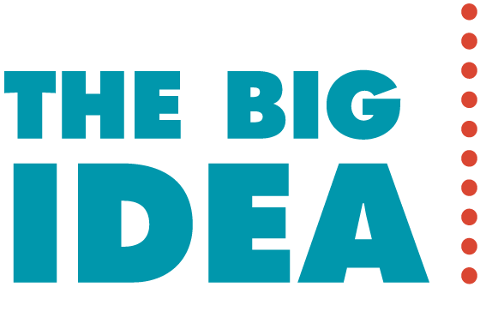
For every force, there is an equal and opposite force.

Slide 2
7.2 Newton’s Third Law
Newton’s third law states that whenever one object exerts a force on a second object, the ____________ object exerts an equal and opposite force on the __________object.
(hand demo)

Slide 3
7.2 Newton’s Third Law
Newton’s third law describes the relationship between two forces in an interaction.
One force is called the _____________ force.
The other force is called the ____________force.
Neither force exists without the other.
They are equal in strength and opposite in direction.
They occur at the _________ _____________ (simultaneously).
(bridge)

Slide 4
Action-Reaction Force Pairs
Action-Reaction force pairs never cancel because ________________________________________________.
F_{A} - Force of ball on racket
F_{B} - Force of racket on ball

Slide 5
7.4 Action and Reaction on Different Masses
A given force exerted on a small mass produces a __________________ acceleration than the same force exerted on a large mass.

Slide 6
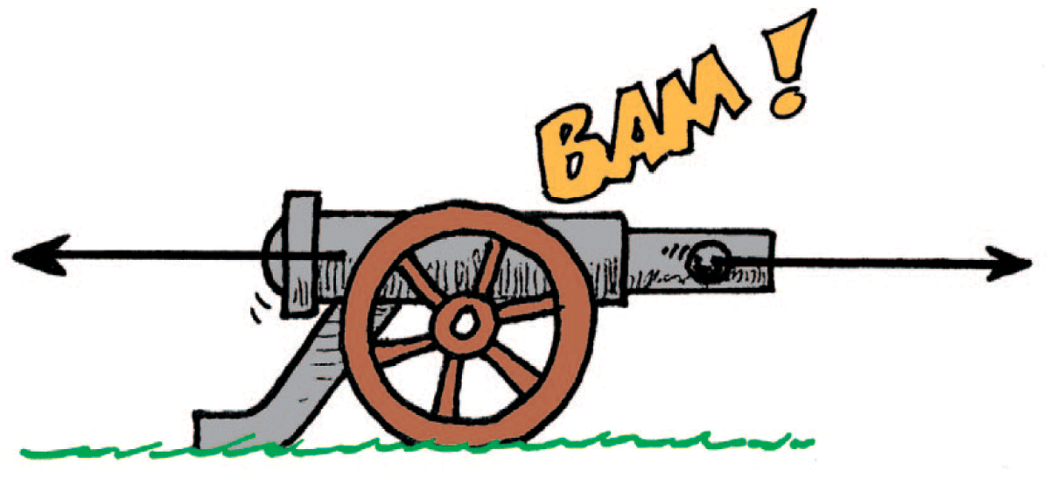
7.4 Action and Reaction on Different Masses
The cannonball undergoes more acceleration than the cannon because its mass is much smaller.

Slide 7
7.4 Action and Reaction on Different Masses
F represents both the action and reaction forces; m (large), the mass of the cannon; and m (small), the mass of the cannonball.
Do you see why the change in the velocity of the cannonball is greater compared with the change in velocity of the cannon?

Slide 8
7.5 Defining Systems
Why don’t action-reaction forces cancel each other?

Slide 9
7.5 Defining Systems
Action and reaction forces do not cancel each other when either of the forces is external to the system being considered.

Slide 10
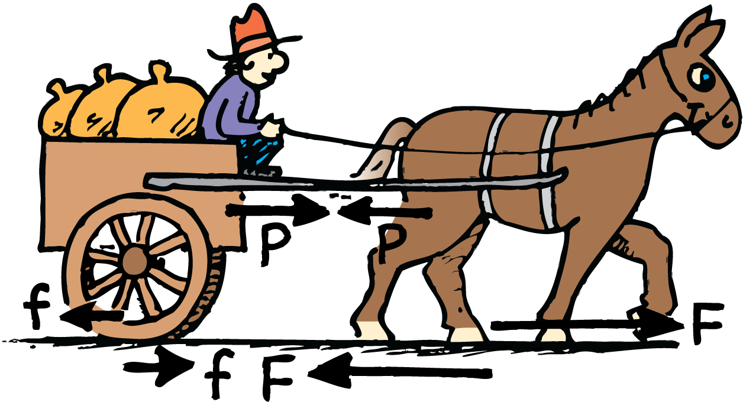
7.6 The Horse-Cart Problem
All the pairs of forces that act on the horse and cart are shown. The acceleration of the horse-cart system is due to the net force F – f.

Slide 11
7.6 The Horse-Cart Problem
think!
What is the net force that acts on the cart? On the horse? On the ground?

Slide 12
7.6 The Horse-Cart Problem
Will the horse’s pull on the cart be canceled by the opposite and equal pull by the cart on the horse, thus making acceleration impossible?
Think of the system….

