Slide 1
An object _______________ when a _____ force acts on it.

Slide 2
6.1 Force Causes Acceleration
______________ forces acting on an object cause the object to accelerate.

Slide 3
6.1 Force Causes Acceleration
Recall from the previous chapter that the combination of forces acting on an object is the __________ force.
Acceleration depends on the _________ force.
To increase the acceleration of an object, you must increase the net force acting on it.
An object’s acceleration is directly proportional to the net force acting on it:
acceleration ~ net force
(The symbol ~ stands for “is ___________________to.”)

Slide 4
6.2 Mass Resists Acceleration
For a constant force, an increase in the __________ will result in a ___________ in the acceleration.

Slide 5
6.2 Mass Resists Acceleration
The same force applied to ____________ as much mass results in only __________ the acceleration.
The acceleration is ______________ proportional to the mass.
Inversely means that the two values change in opposite directions. As the denominator increases, the whole quantity decreases by the same factor.

Slide 6
6.3 Newton’s Second Law
Newton’s second law states that the acceleration produced by a net force on an object is directly proportional to the magnitude of the net force, is in the same direction as the net force, and is inversely proportional to the mass of the object.
OR in term’s of an equation:
a =

Slide 7
6.4 Friction
The force of friction between the surfaces depends on the kinds of material in contact and how much the surfaces are pressed together.

Slide 8
6.4 Friction
Friction results from the two surfaces being pressed together closely, causing intermolecular attractive forces between molecules of different surfaces.
As such, friction depends upon the nature of the two surfaces and upon the degree to which they are pressed together.

Slide 9
The maximum amount of friction force that a surface can exert upon an object can be calculated using the formula below:
F_{frict} = µ • F_{norm}

Slide 10
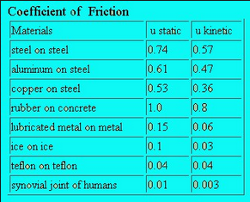
Coefficients of Friction …

Slide 11
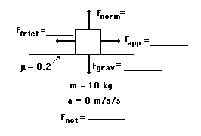
Using the Coefficient of Friction
F_{friction} = µ * F_{normal}
Example #1:
A rightward force is applied to a 10-kg object to move it across a rough surface at constant velocity. The coefficient of friction between the object and the surface is 0.2. Use the diagram to determine the gravitational force, normal force, applied force, frictional force, and net force. (Neglect air resistance.)

Slide 12
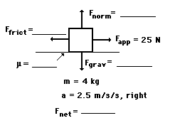
Example #2:
A rightward force of 25 N is applied to a 4-kg object to move it across a rough surface with a rightward acceleration of 2.5 m/s/s. Use the diagram to determine the gravitational force, normal force, frictional force, net force, and the coefficient of friction between the object and the surface. (Neglect air resistance.)

