Slide 1
MECHANICAL EQUILIBRIUM
Ch 2

Slide 2
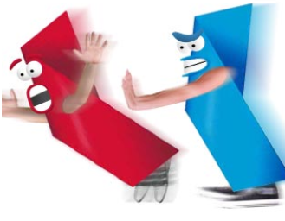
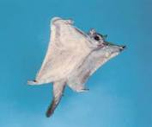
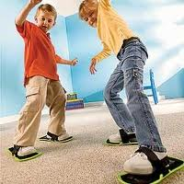
CONTACT FORCES
___________ Force – a push or a pull given by some other object. (F )
_____________ Force – drag between a moving object and a surface. (F )
__________________– the drag that opposes objects moving through a fluid. (F )

Slide 3
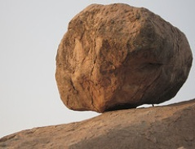
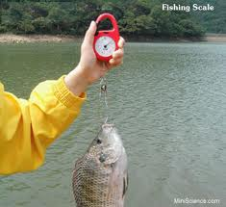
CONTACT Forces
_________ Force or ________ Force – the upward force that balances the weight of an object – always ┬ to surface. (F )
__________ Force – Stretching force on a spring (F )
__________ Force – Stretching force of a rope. (F )

Slide 4
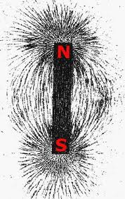
AT A DISTANCE FORCES
________________ Force – an object’s weight always directed straight down to Earth. (F )
___________________ Force – interaction between charged particles. (F )

Slide 5
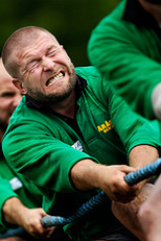
Forces are ____________!
Forces have direction.
Two forces pushing or pulling in the _________ direction will _________ together.
Two forces pushing or pulling in ___________ directions will _____________.

Slide 6
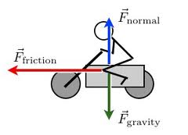
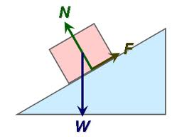
Free Body Diagrams:
Show all the forces acting on a body.

Slide 7
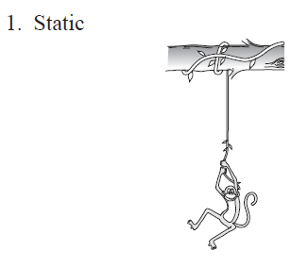
Practice Problems:

Slide 8
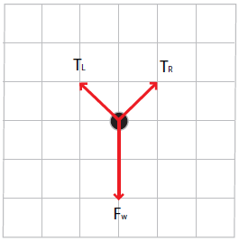
2. Static

Slide 9
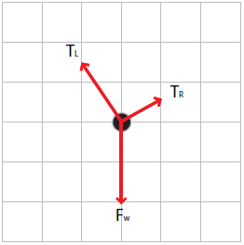
#3. Static

Slide 10
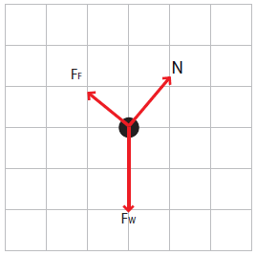
#4. Static

Slide 11
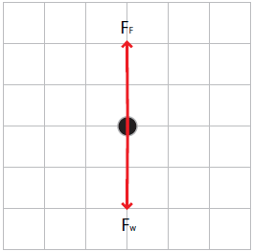
#5. Dynamic ( falling at constant terminal velocity)

Slide 12
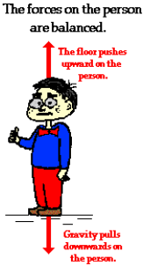
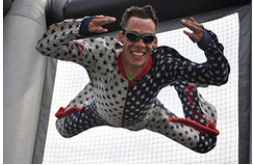
EQUILIBRIUM RULE:
When the _______ force on an object is _______, its motion is unchanging.
∑ F = 0

Slide 13
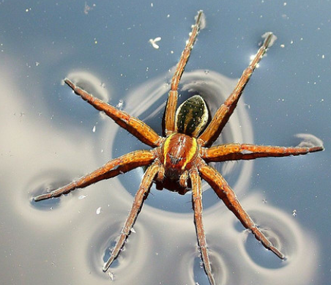
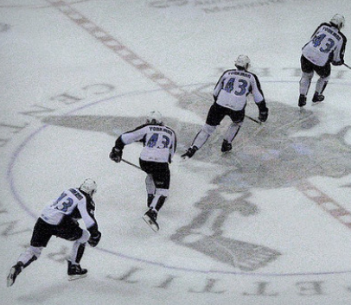
Two types of Mechanical Equilibrium
___________ Equilibrium – object is at _____.
________ Equilibrium – object is moving at _________ speed in a straight line.

Slide 14
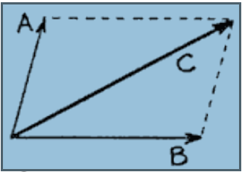
PARALLELOGRAM RULE
To find the resultant force of two non-parallel vectors, construct a parallelogram out of the two vectors and ________________ shows the resultant.
Resultant is C

Slide 15
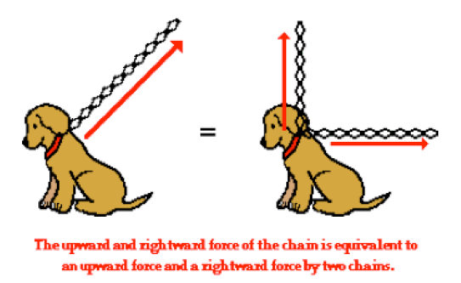

Slide 16
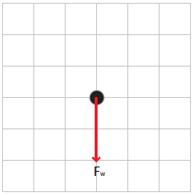
Falling with no air friction?
Constant state of motion OR acceleration?

Slide 17
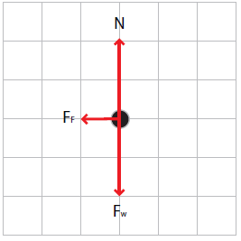
Slowing down because of friction?
Constant state of motion OR acceleration?

Slide 18
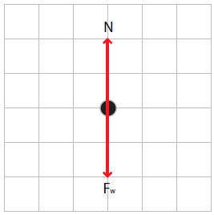
Sliding at constant speed without friction?
Constant state of motion OR acceleration?

