Slide 1
WAVES & VIBRATIONS

Slide 2
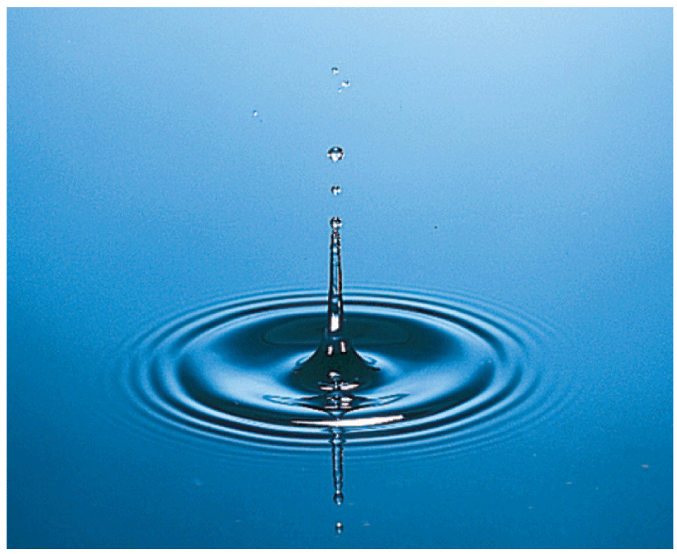
Waves transmit _____________ through space and time.
A disturbance that is transmitted progressively from one place to the next with ________ actual transport of matter is a wave.

Slide 3
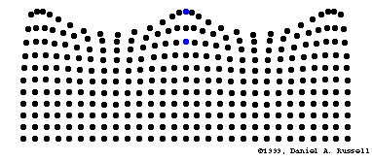

Slide 4
Waves - Types and Properties
__________________ Wave
Oscillations ______________ to direction of wave travel
Examples: waves on a rope, electromagnetic waves (light, x-rays, etc., some seismic waves)

Slide 5
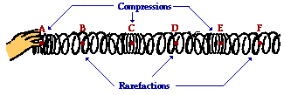
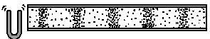
Waves - Types and Properties
___________________ Wave
oscillations in __________ directions as wave travels
Examples: sound, some seismic waves, dominoes
Video

Slide 6
If the horizontal axis represents distance, Letter X represents the ______ of the wave
amplitude
wavelength
period
frequency
X

Slide 7
If the horizontal axis represents time, Letter X represents the ______ of the wave
amplitude
wavelength
period
frequency
X

Slide 8
Letter _____ represents the amplitude of the wave
O
P
Q
P
Q
O

Slide 9
If the following waves differ in
What does this mean in terms of light and sound?
Notes:
need frequency generator and speaker and

Slide 10
If the following waves differ in
What does this mean in terms of light and sound?

Slide 11
25.2 Wave Description
The high points on a wave are called ______________________.
The low points on a wave are called ______________________.
The term ___________________ refers to the distance from the midpoint to the crest (or trough) of the wave.
The amplitude is the maximum displacement from ______________________.

Slide 12
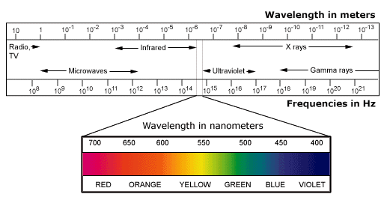
videos
Notes:
source: http://saturn.jpl.nasa.gov/mission/images/EM-spectrum.jpg

Slide 13
Frequency Range of “Hearing” for Various Species*
Human | 20-20,000 Hz
Cat | 45-64,000 Hz
Dog | 67-45,000 Hz
Cow | 23-35,000 Hz
Horse | 55-33,500 Hz
Mouse | 1,000-91,000 Hz
Bat | 2,000-110,000 Hz
Beluga whale | 1,000-123,000 Hz
Elephant | 16-12,000 Hz
Parakeet | 200-12,000 Hz
* Average ranges shown – sources vary as to exact ranges
Notes:
http://www.lsu.edu/deafness/HearingRange.html

Slide 14
FREQUENCY
The _______________________ specifies the number of back-and-forth vibrations in a given time (usually one second).
A complete back-and-forth vibration is one cycle.
The unit of frequency is called the __________ (Hz) = cycles per second.

Slide 15
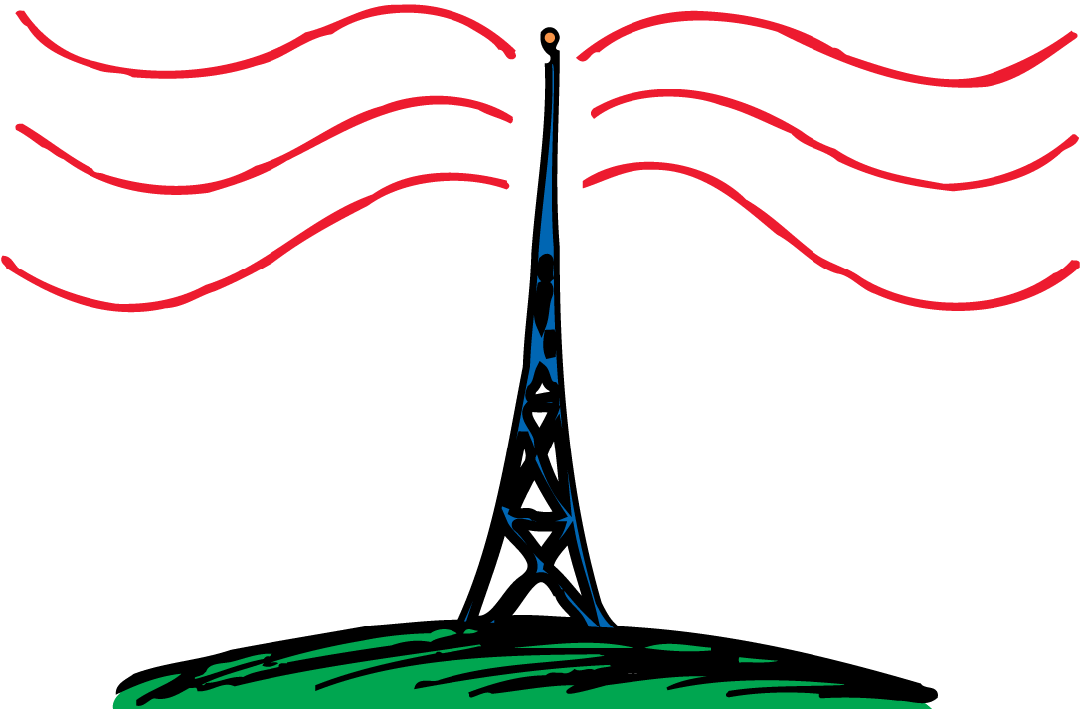
25.2 Wave Description
Electrons in the antenna of an AM radio station at 960 kHz vibrate 960,000 times each second, producing 960-kHz radio waves.

Slide 16
Mathematics of Waves
Relationship between frequency and period
f = 1/T or T = 1/f
Speed
v = f λ
Speed of sound:
v = 331 m/s + (0.61 x T) (T in Celsius)
Speed of light:
speed in vacuum = 3 x 10⁸ m/s
Notes:
End of Day 1

Slide 17
25.3 Wave Motion
think!
The Sears Tower in Chicago sways back and forth at a frequency of about 0.1 Hz. What is its period of vibration?
Notes:
10 sec

Slide 18
25.4 Wave Speed
think!
If a water wave vibrates up and down two times each second and the distance between wave crests is 1.5 m, what is the frequency of the wave? What is its wavelength? What is its speed?
Notes:
Freq = 2 wavelength = 1.5m speed = 1.5*2 = 3 m/s

Slide 19
What is the frequency of a wave that has a period of 0.0080 s?
0.0080 Hz
0.0040 Hz
125 Hz
250 Hz

Slide 20
What is the wavelength of a sound wave with a frequency of 240 Hz if the wave is traveling at 350 m/s?
1.5 m/s
1.9 m/s
2.3 m/s
4.1 m/s

